Slide 1
CSCI 1130 Tutorial One

Slide 2
Using Java SE (JDK 10) with NetBeans 9.0
CSCI 1130
Tutorial one

Slide 3
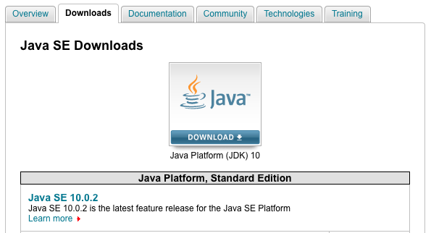
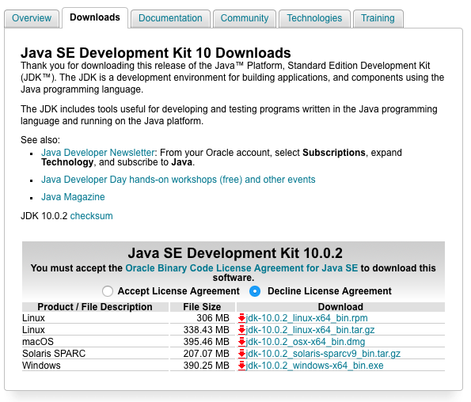
Download and install JDK 10.0.2
http://www.oracle.com/technetwork/java/javase/downloads/index.html
Click it to download JDK 10
Choose “Accept License Agreement” and download according to your OS

Slide 4
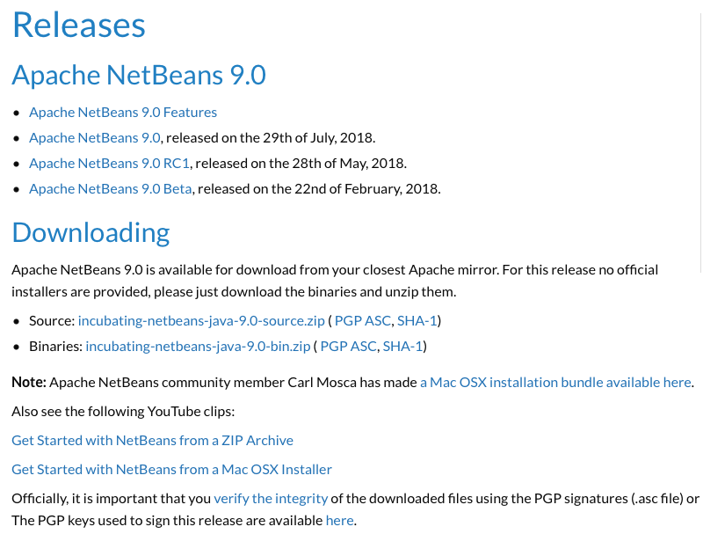
Download NetBeans IDE 9.0 SEPARATELY
https://netbeans.apache.org
Windows users: download the binary *-bin.zip file and install it according to the first clip
Mac users: can install NetBeans from either the binary file or the Mac OSX Installer

Slide 5
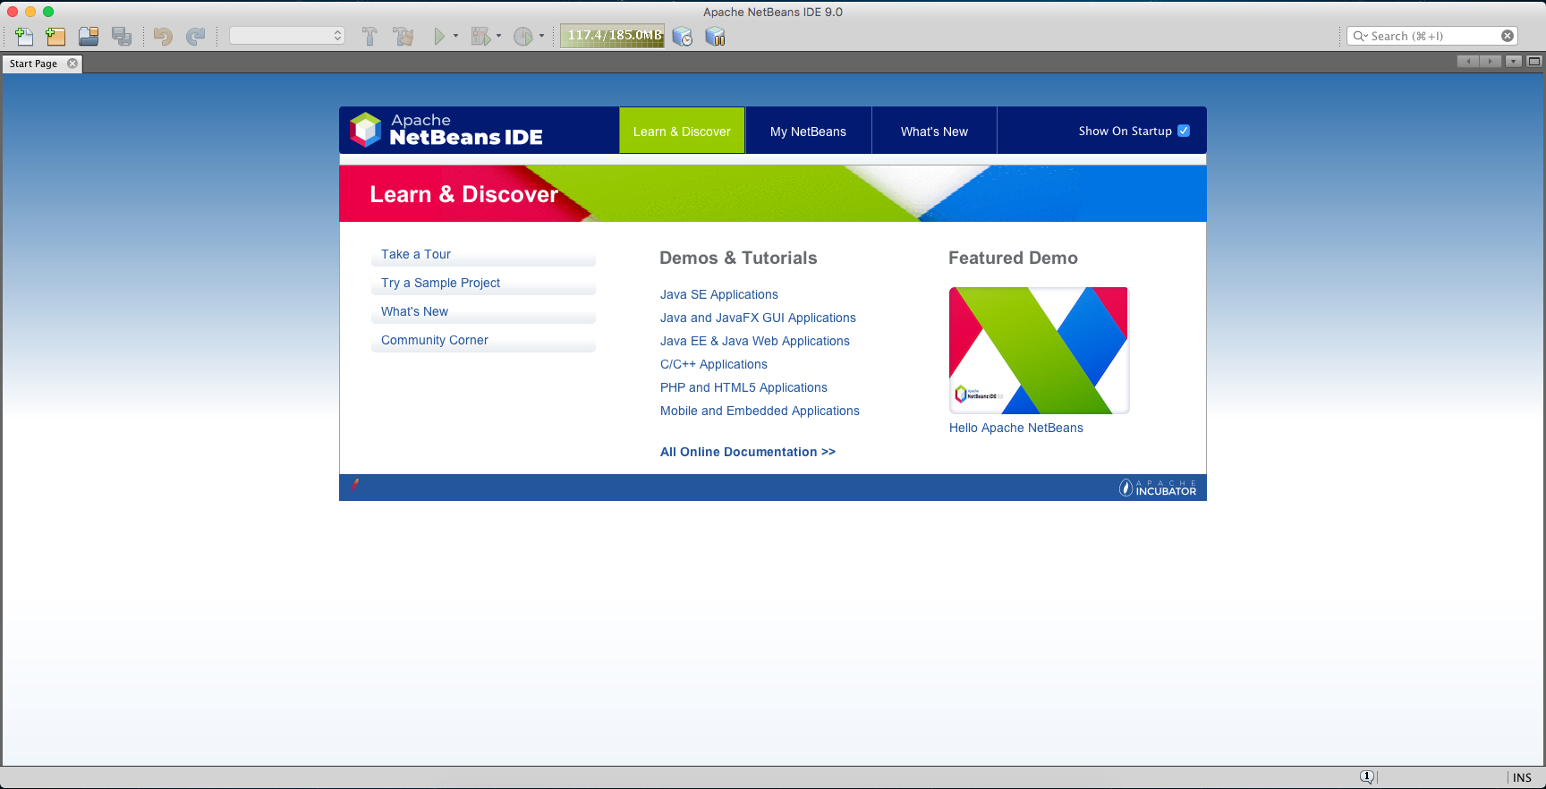
Create a New Project
Click “New Project…”

Slide 6
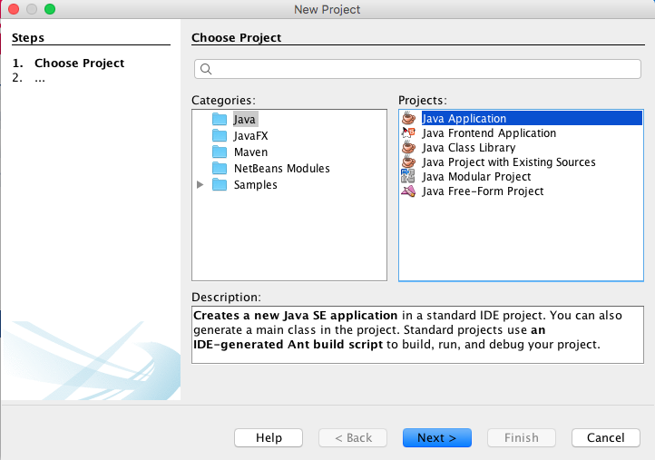
Java → Java Application

Slide 7
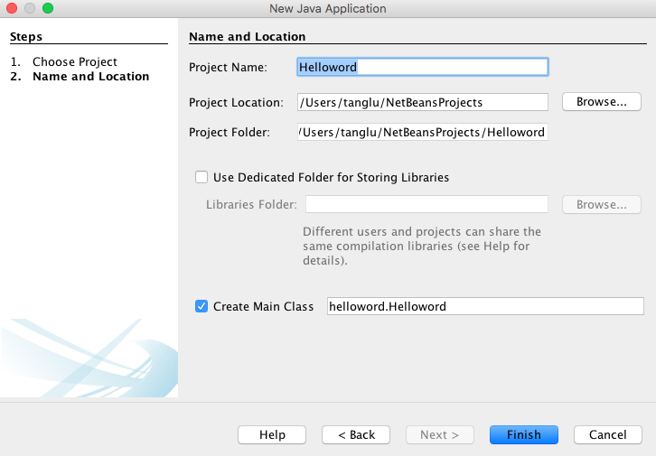
Give Project Name and Location
Store the project anywhere you like but please remember the location!
The default is recommended!
Click “Finish”

Slide 8
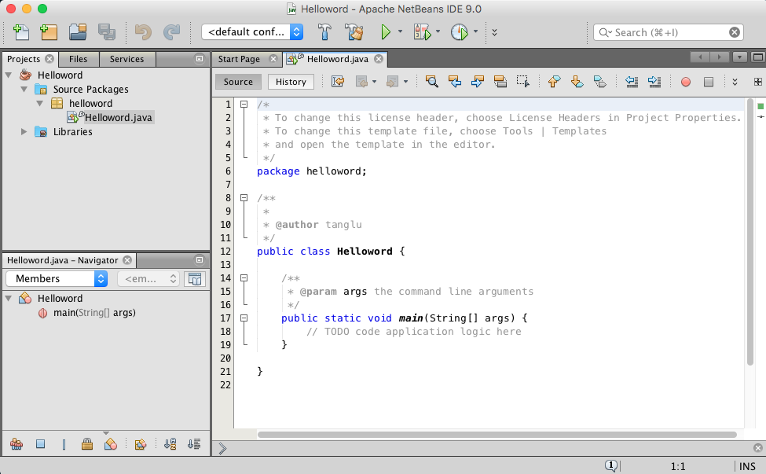
Initial Java Project
A new initial Java source file is created automatically!

Slide 9
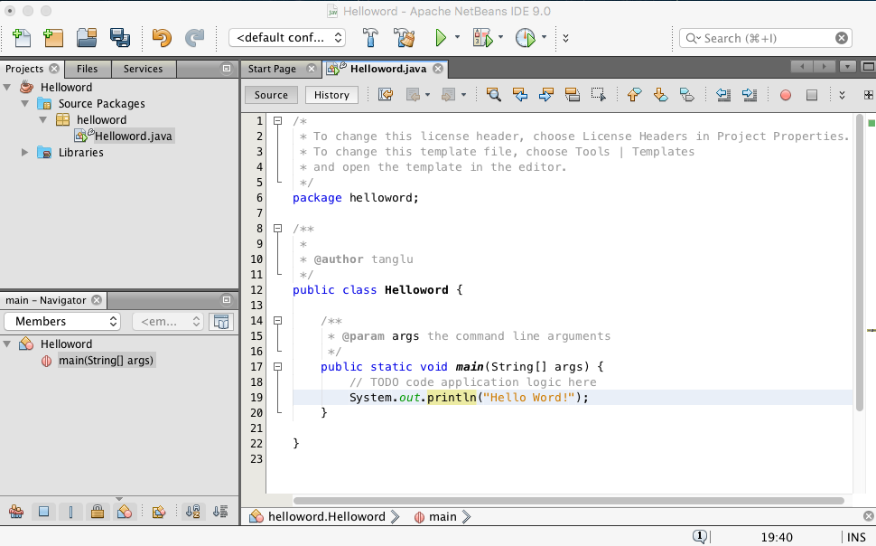
Exercise1: Hello World!

Slide 10
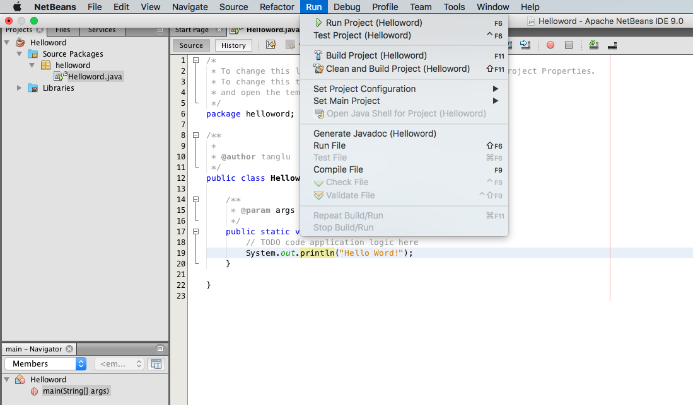
Build your Project
“Run Project (F6)” will perform “Build Project” and RUN the program.
“Build Project (F11)” will check your source code and compile your program.
Click “Clean and Build Project” if you encounter any mysterious problem…

Slide 11
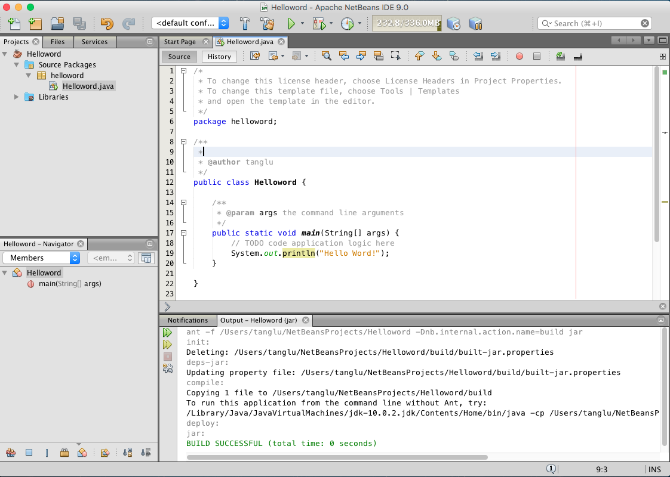
How to Build a Project

Slide 12
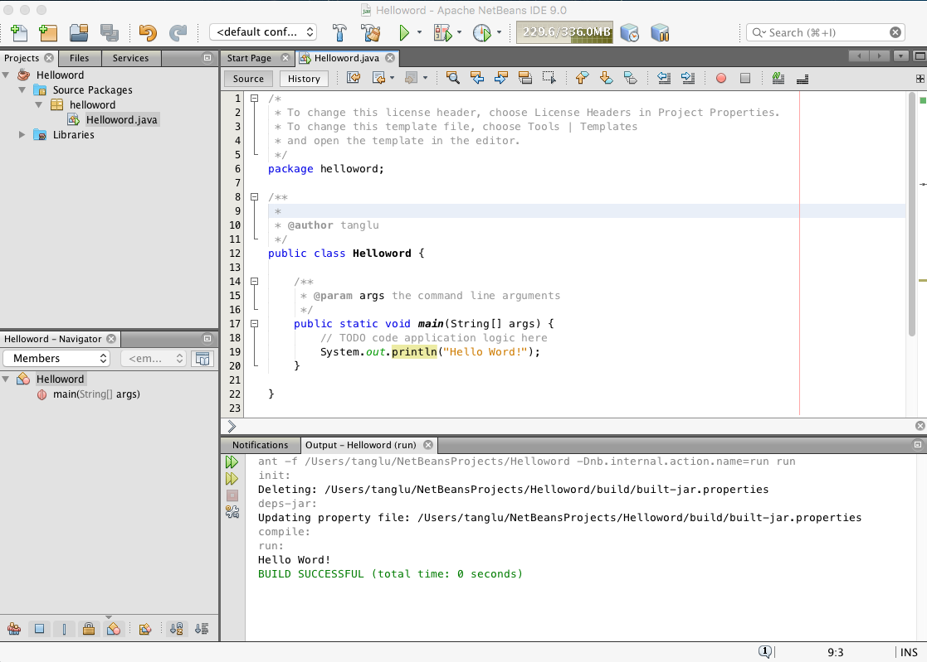
How to Run

Slide 13
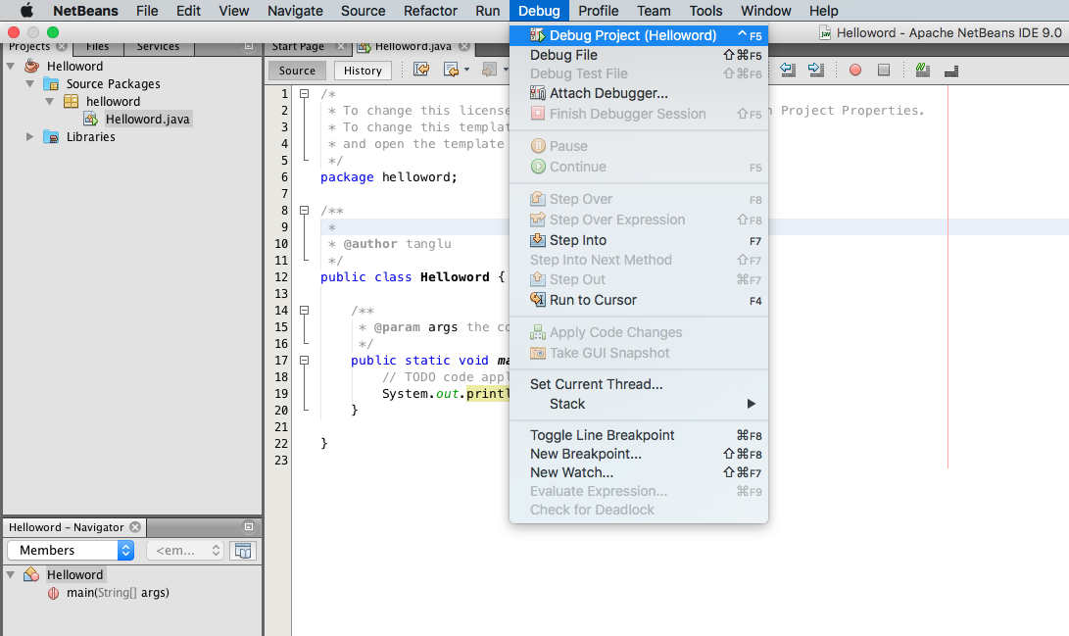
How to Debug
“Debug Project” is another way to Run your Project, it will also perform “Build Project” and RUN the program with debugger support.

Slide 14
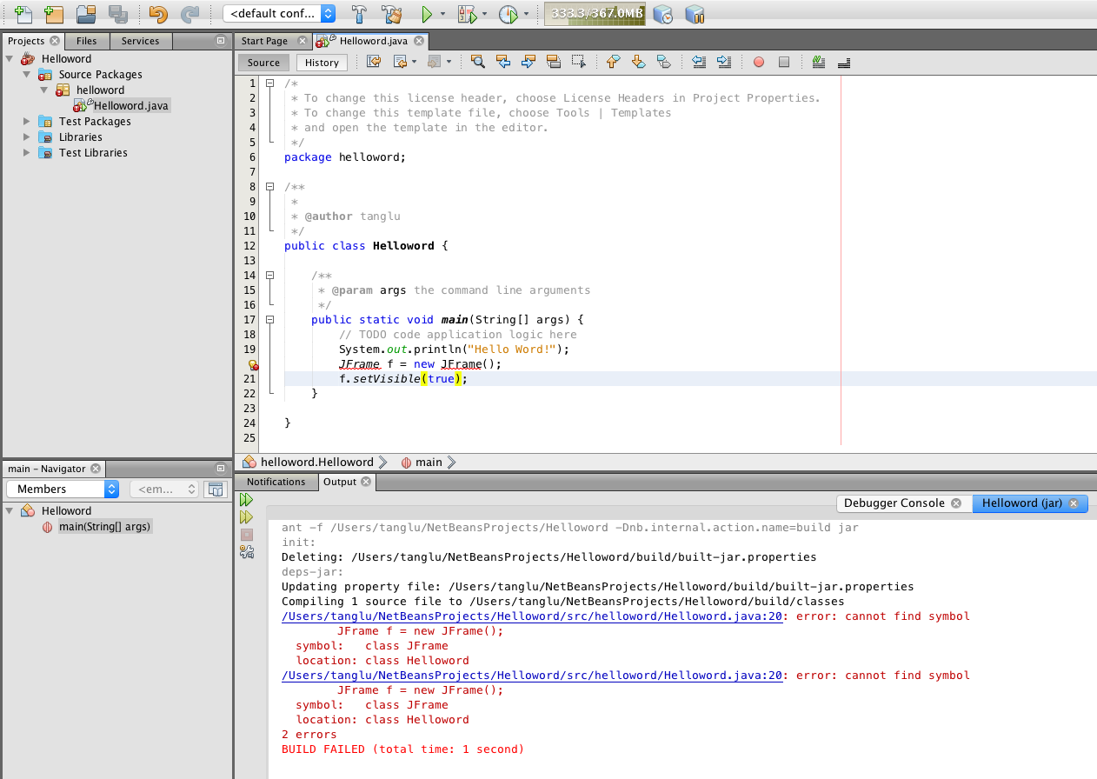

Exercise2: Create a JFrame

Slide 15
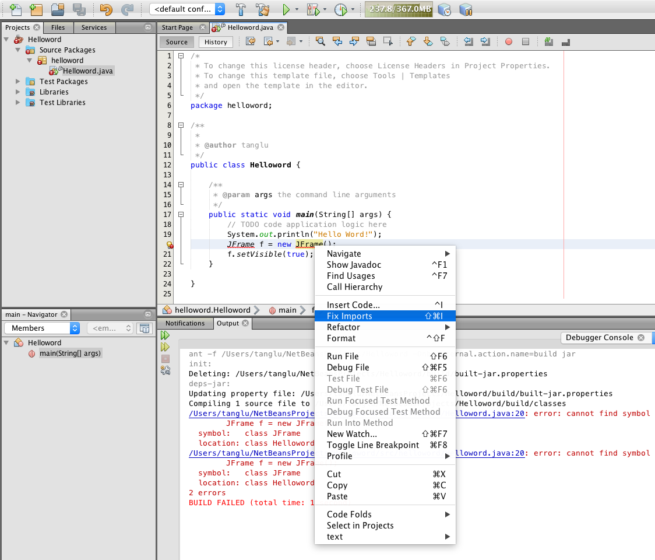
Right-click → Fix Imports

Slide 16
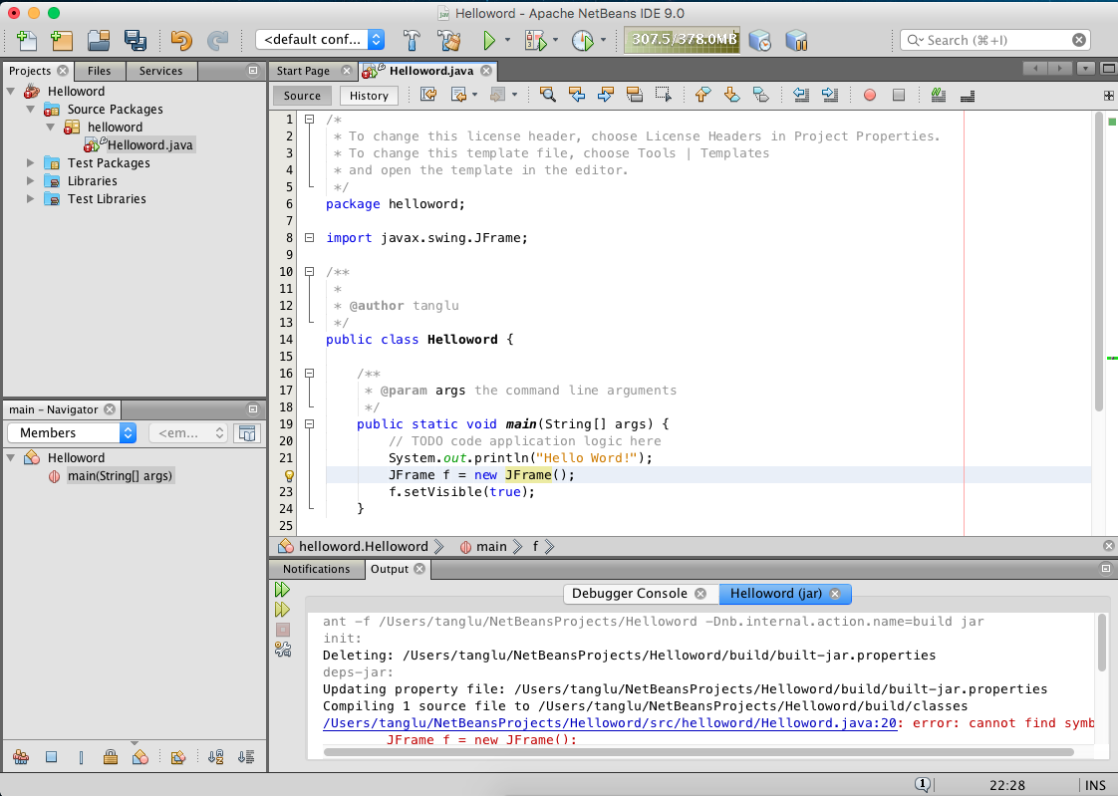
Build Again

Slide 17
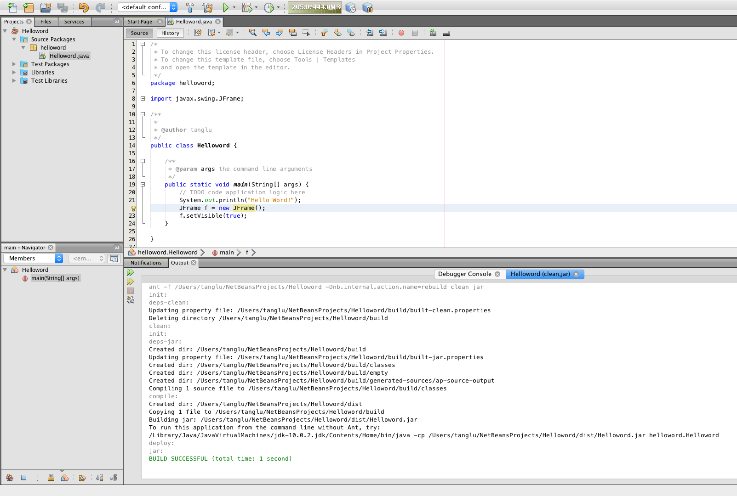
Build Successful
Click “Clean and Build”

Slide 18
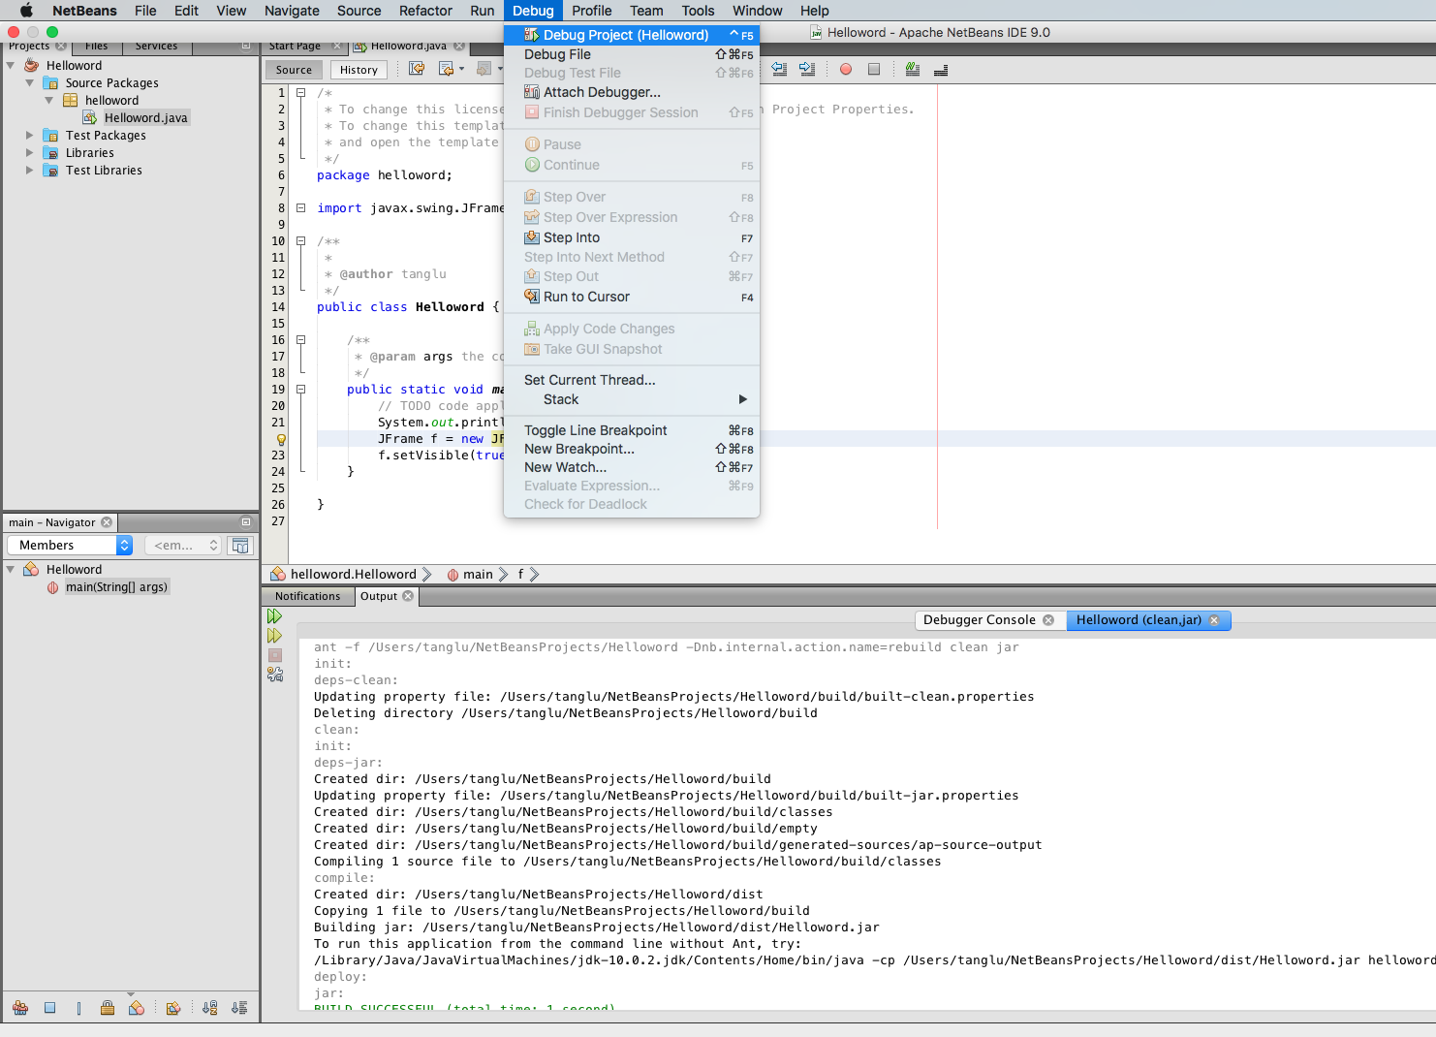
Debug Main Project

Slide 19
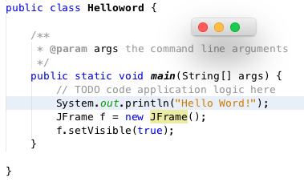
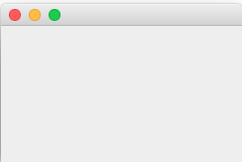
A JFrame Window is Shown! Let’s Resize it…
Clicking this little cross ONLY dismisses the JFrame window,
BUT the program will still be running in the background…

Slide 20
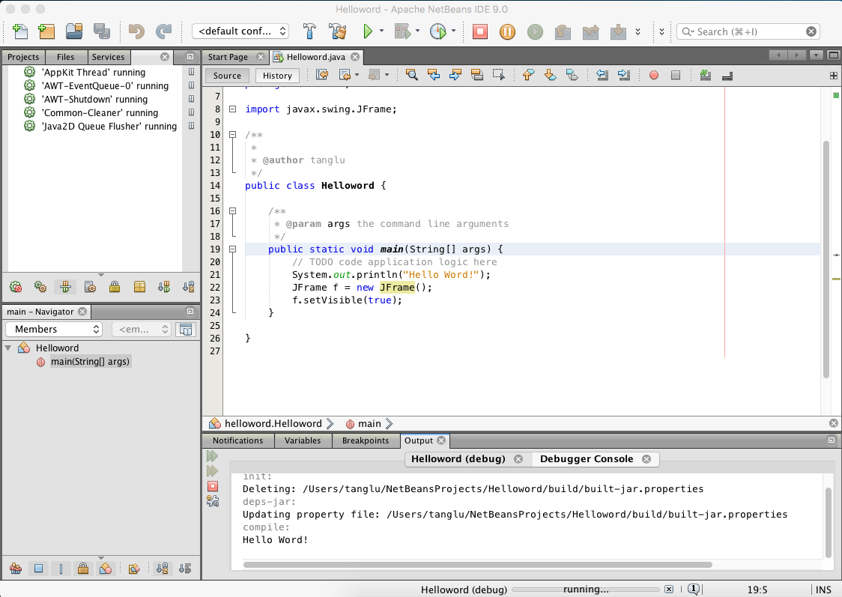
Finish Debugger Session
To stop this simple program,
we have to finish the Debugger Session.

Slide 21
Summary
You have learnt…
Download and Install JDK as well as NetBeans
Launch NetBeans
Create a New Java Application Project
Edit a simple “Hello World” program
Build/ Run/ Debug a project
Create a simple JFrame window
Fix a simple kind of error by clicking [Fix Imports]
Finish a Debugger Session

Slide 22
The End

